Slide 1

SOFTWARE ENGINEERING
REQUIREMENT PLANNING
Group-07
● Islam,khandaker md tousif
● Tazrian zaman tushti
● Hasan,shadik
●AFIQUE SADIQUE

Slide 2
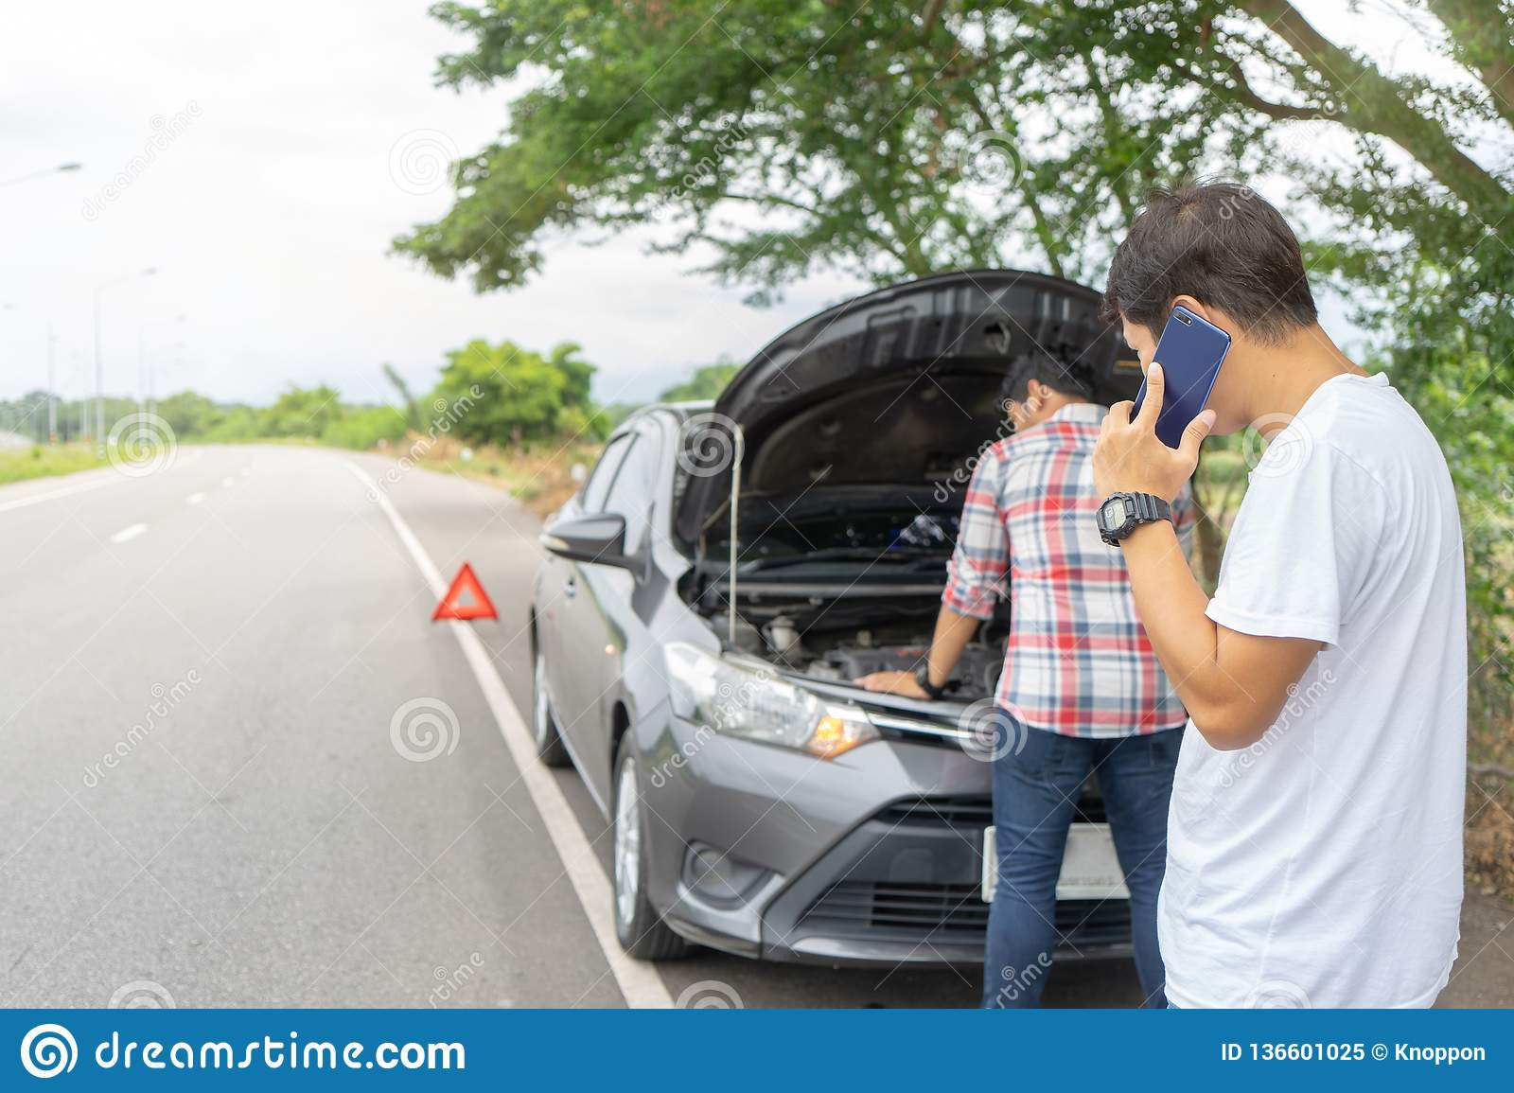
EMERGENCY AUTOMOBILE TECHNICIAN SERVICE
Reconditioned vehicles are used more in Bangladesh. These cars can have mechanical problems at any time. Passengers suffer especially if there is a mechanical problem while driving on the highway. They can't find automobile technicians anywhere on the highway.

Slide 3
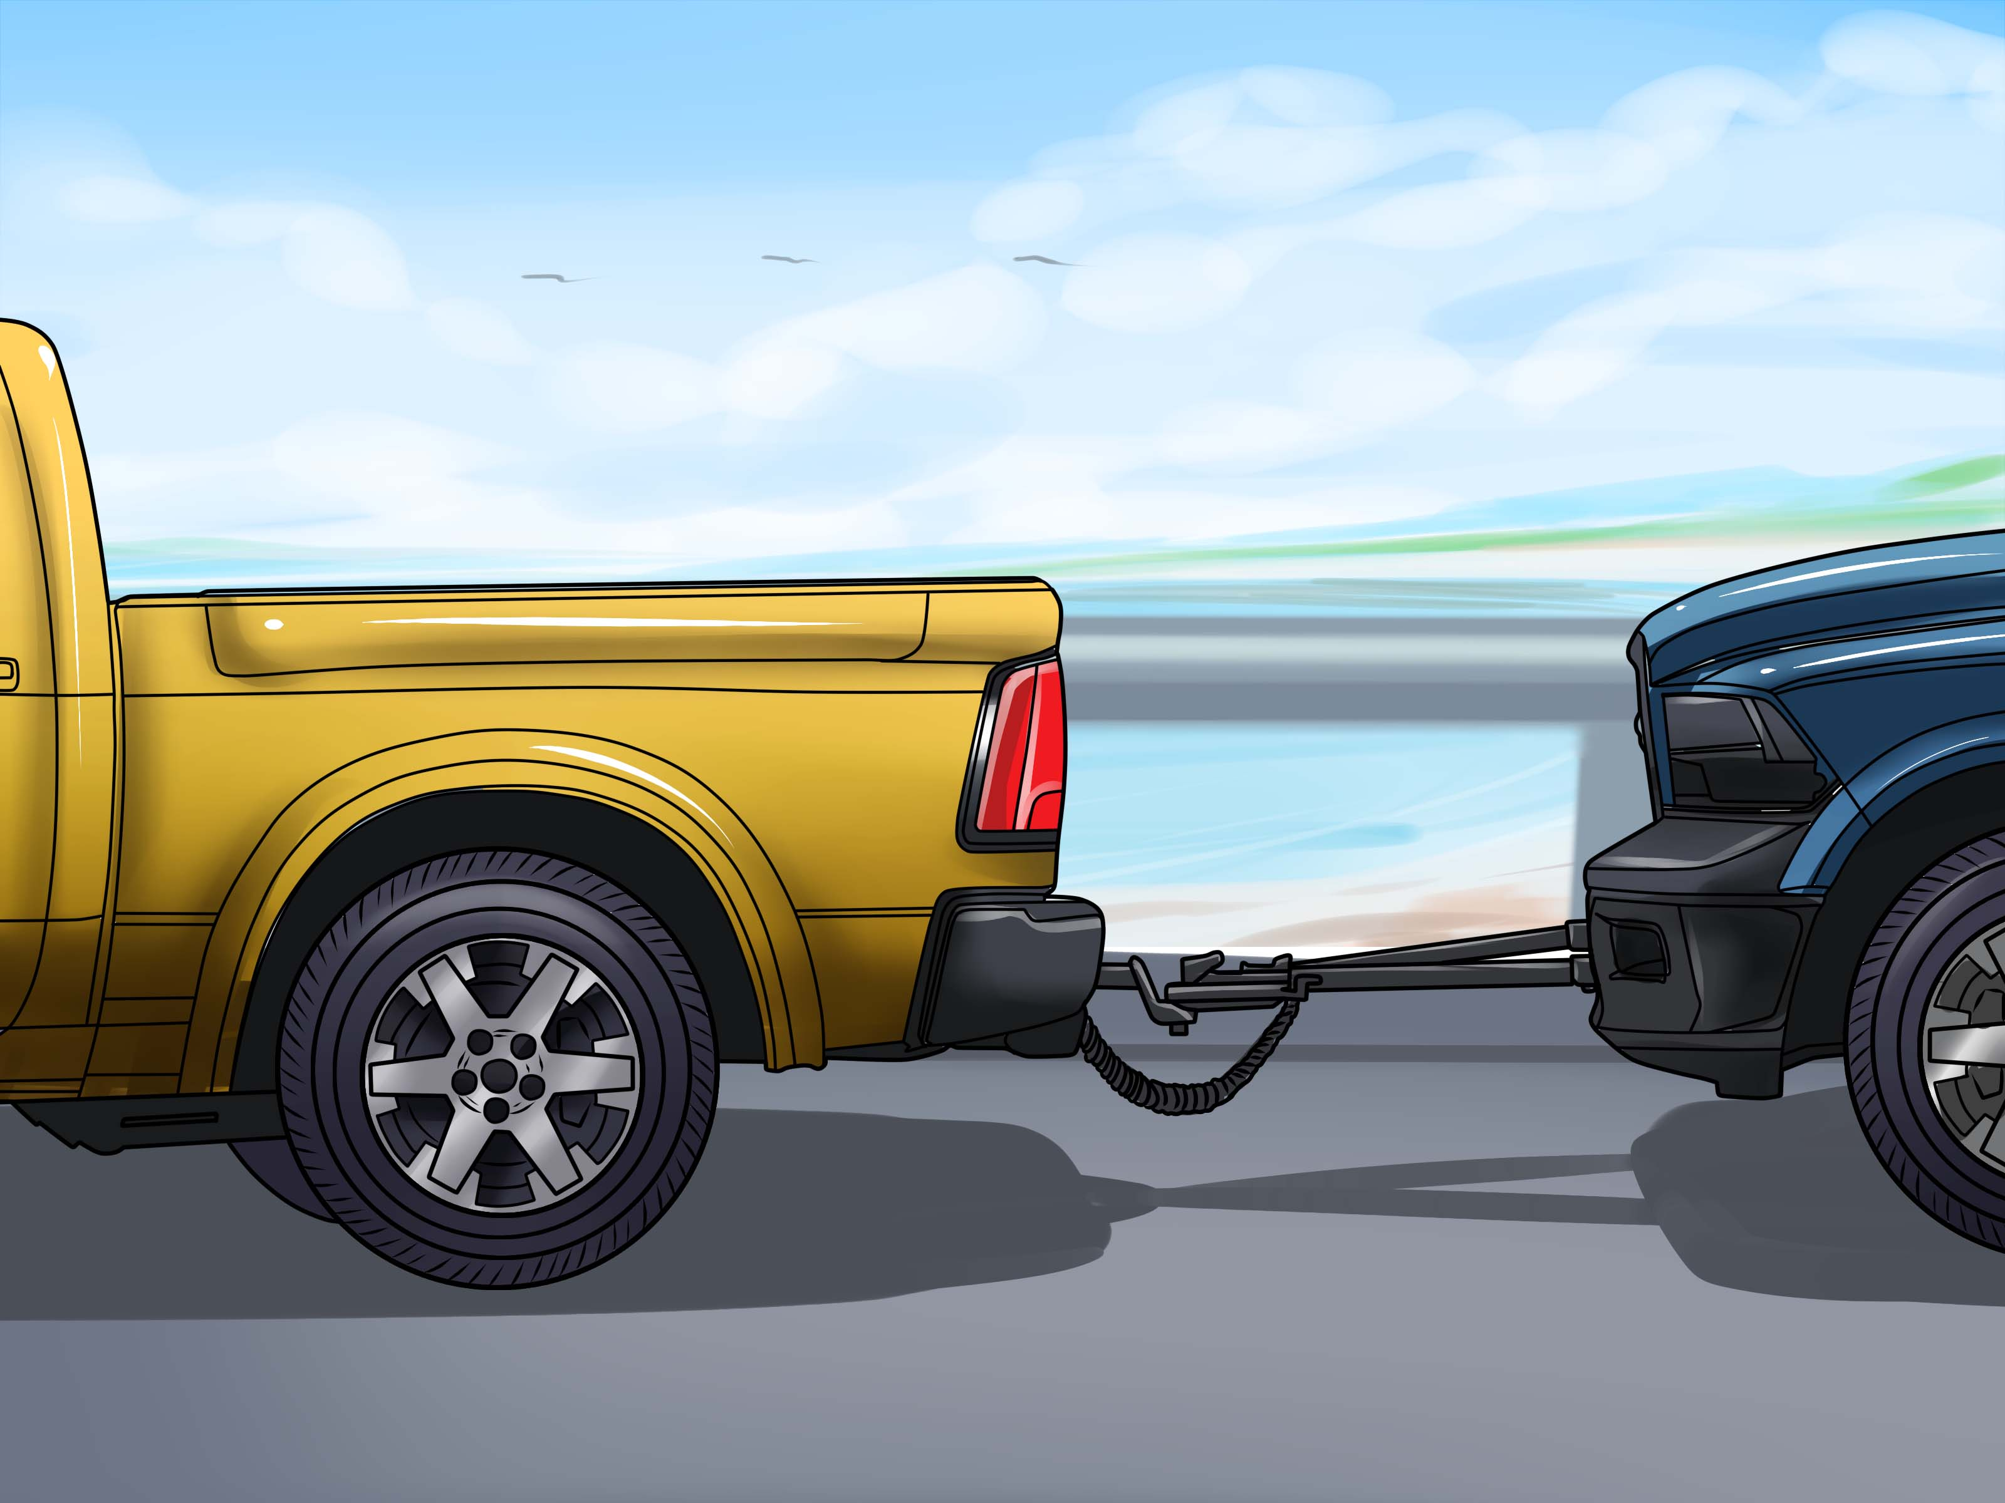
That's why they have to rent another vehicle and take the wrecked vehicle. As a result they waste their valuable time as well as spend extra money.

Slide 4
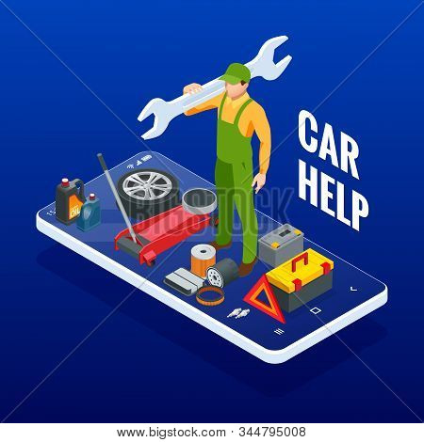
To solve this problem, we are introducing a system through which the driver of the vehicle can get the service immediately by contacting with the nearest automobile technician via location sharing.
Those who drive vehicles are our target audience
At present the total number of vehicles in Bangladesh 5004130.000 Unit [year 2019] . And whose number is increasing day by day.

Slide 5
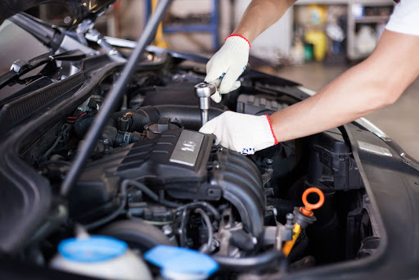
In addition, customers will be able to receive their desired service from the technician of their choice from home. As a result, customers do not have to go to any workshop with their vehicle.

Slide 6
REFERENCES
https://www.google.com/search?q=CAR+PULLING+BY+A+TRUCK&tbm=isch&ved=2ahUKEwiT8fag29ruAhXFdisKHbGABHAQ2-cCegQIABAA&oq=CAR+PULLING+BY+A+TRUCK&gs_lcp=CgNpbWcQAzoHCCMQ6gIQJzoECCMQJzoECAAQQzoCCAA6CAgAELEDEIMBOgUIABCxAzoHCAAQsQMQQzoKCAAQsQMQgwEQQzoGCAAQBRAeOgYIABAIEB5Q4IQBWKX2AWDU-AFoBXAAeACAAagBiAGUG5IBBDAuMjaYAQCgAQGqAQtnd3Mtd2l6LWltZ7ABCsABAQ&sclient=img&ei=aGchYJOdDMXtrQGxgZKABw&bih=666&biw=1536#imgrc=m6iX7-qEJojBSM
https://www.google.com/search?sxsrf=ALeKk01wB9Uy0qGFpbouhsal9csH56tLtg%3A1612799709998&ei=3V4hYK_BPKjaz7sPhduS8A4&q=TOTAL+PRIVATE+CAR+IN+BANGLADESH&oq=TOTAL+PRIVATE+CAR+IN+BANGLADESH&gs_lcp=CgZwc3ktYWIQAzICCAA6BwgAEEcQsAM6BwgjELACECc6BggAEAcQHjoGCAAQCBAeOggIABAIEAcQHlCbR1iWd2CXf2gBcAJ4AIABwQGIAZENkgEEMC4xMZgBAKABAaoBB2d3cy13aXrIAQjAAQE&sclient=psy-ab&ved=0ahUKEwjvo7uO09ruAhUo7XMBHYWtBO4Q4dUDCA0&uact=5

